Slide 1
Machine Learning data processing
Credit card fraud detection Case Demo

Slide 2
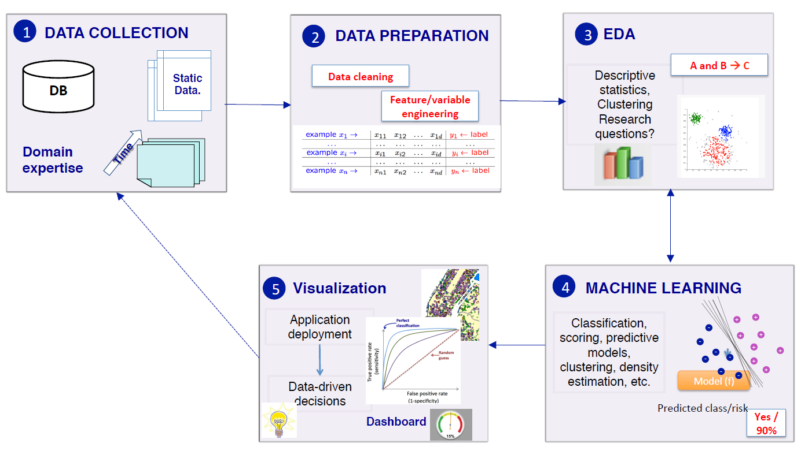
The Data Science process

Slide 3
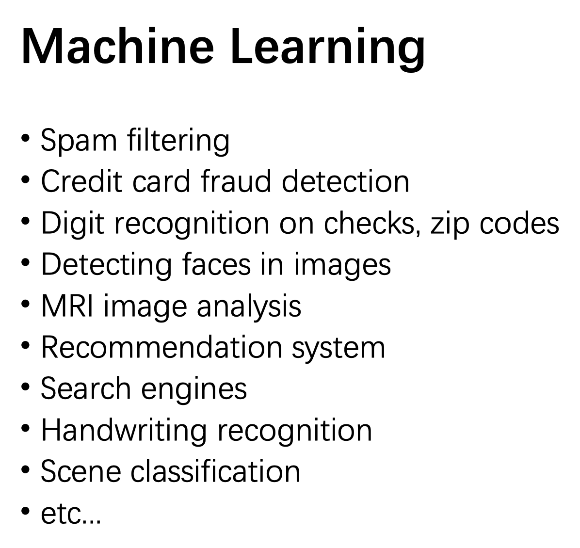
Data collection
Data Preparation
Exploration Data Analysis
Modeling
Visualization

Slide 4
How to find datasets?
Big data competition platform
Kaggle: https://www.kaggle.com/datasets
Colleges and Universities
UCI: https://archive.ics.uci.edu/ml/datasets.html
Enterprises or public welfare organizations
Google dataset: https://cloud.google.com/bigquery/public-data/
Government’s open data
The U.S. Government’s open data: https://data.gov/
Searching datasets:
https://datasetsearch.research.google.com/

Slide 5
Credit card fraud detection
Data collection
Data Preparation
Exploration Data Analysis
Modeling
Visualization
www.kaggle.com/mlg-ulb/creditcardfraud
Download the dataset : creditcard.csv

Slide 6
Data Preparation
Data collection
Data Preparation
Exploration Data Analysis
Modeling
Visualization
Eliminates duplicate and null values, corrupt data, inconsistent data types, invalid entries, missing data, and improper formatting.
Python libraries for Data Preparation
NumPy
NumPy is the foundation for many other packages that hold the data science ecosystem like Pandas, Matplotlib and Scikit-learn.
Pandas
Pandas offer developers fast, efficient and optimized objects for data manipulation in various academic and industrial fields.
Matplotlib
The core package used for data visualization. Matplotlib offers various plots and figures developers can use to create different visualizations

Slide 7
Pandas
DataFrame : A Pandas DataFrame is a 2-dimensional data structure, like a 2-dimensional array, or a table with rows and columns.
pandas.read_csv(): Load a CSV into a DataFrame
pandas.DataFrame.head(): returns the headers and a specified number of rows, starting from the top.
pandas.DataFrame.tail(): viewing the last rows of the DataFrame
pandas.DataFrame.info():viewing more information about the data set.
pandas.DataFrame.loc(): Access a group of rows and columns by label(s) or a boolean array.
DataFrame.describe(): Generate descriptive statistics.Descriptive statistics include those that summarize the central tendency, dispersion and shape of a dataset’s distribution, excluding NaN values.

Slide 8
EDA
Data collection
Data Preparation
Exploration Data Analysis
Modeling
Visualization
Analyze and investigate the data set and summarize its key characteristics
V1~V28 are standardized
‘Amount’ is not standardized
Unbalanced sample data
Under sampling
Oversampling
Standardize ‘Amount’
Notes:
数据科学家使用探索性数据分析 (Exploratory Data Analysis) 来分析和调查数据集并总结其主要特征，通常采用数据可视化方法。它有助于确定如何最好地操纵数据源以获得所需的答案，从而使数据科学家更容易发现模式、发现异常、检验假设或检查假设。
EDA 主要用于查看在正式建模或假设检验任务之外可以揭示哪些数据，并提供对数据集变量及其之间关系的更好理解。它还可以帮助确定您正在考虑用于数据分析的统计技术是否合适。EDA 技术最初由美国数学家 John Tukey 在 1970 年代开发，在今天的数据发现过程中仍然是一种广泛使用的方法。

Slide 9
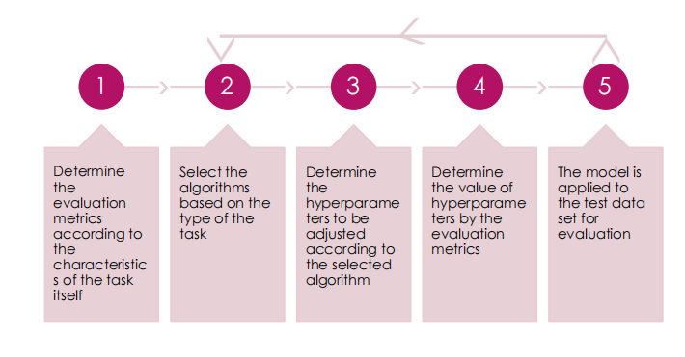
Modeling
Data collection
Data Preparation
Exploration Data Analysis
Modeling
Visualization

Slide 10
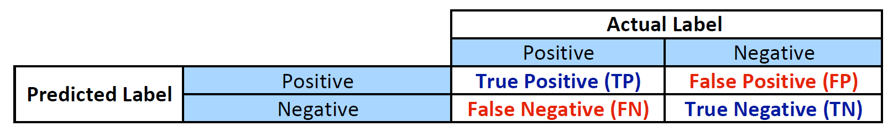
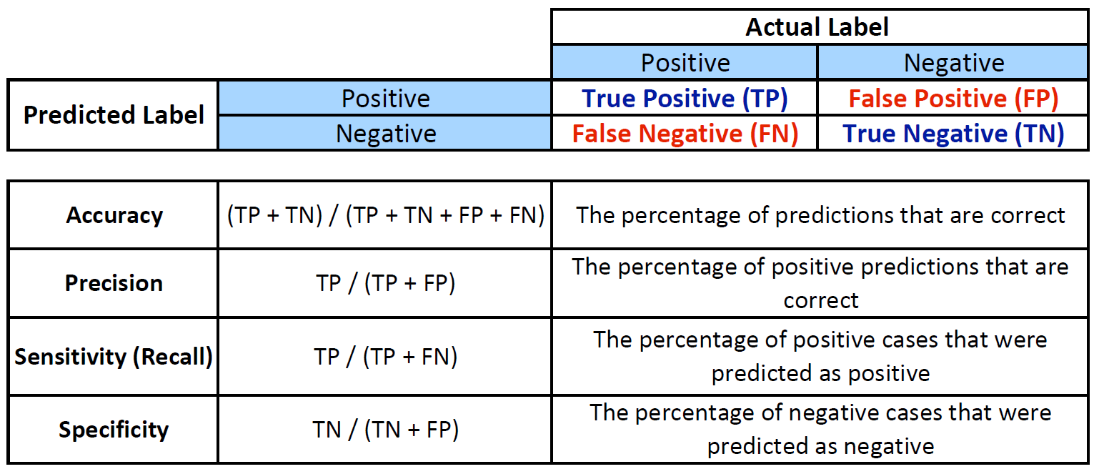
Modeling
1
COVID-19 detection
Spam filtering
Digital Recognition
Court judgments

Slide 11
Modeling
1
1
Determine the evaluation metrics according to the characteristics of the task itself
Credit Card Fraud Detection

Slide 12
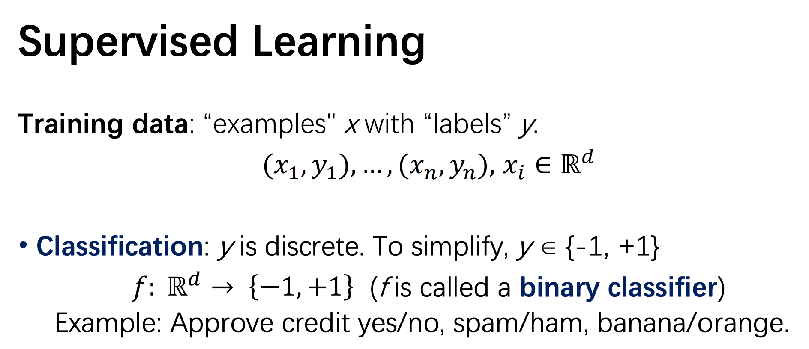
Modeling
2
2
Select the algorithms based on the type of the task
Credit Card Fraud Detection
Methods:
  Logistic Regression
  SVM
  Neural network
  decision tree
  …

Slide 13
Modeling
3
https://scikit-learn.org/stable/modules/generated/sklearn.linear_model.LogisticRegression.html?highlight=logisticregression#examples-using-sklearn-linear-model-logisticregression
3
Determine the hyperparameters to be adjusted according to the selected algorithm
Hyperparameters:
test_size
random_state
penalty
C
max_iter
…
threshold

Slide 14
Visualization
Data collection
Data Preparation
Exploration Data Analysis
Modeling
Visualization
Visualization methods refer to the use of visual representation to display complex resource content after the original data is converted into visual elements and to deepen the user‘s understanding. Some important visualization techniques are histograms, Scatter Plots, timelines, Box and Whisker Plots, and treemaps.

Slide 15
Modeling
4
train_test_split
Train data
Test data
4
Determine the value of hyperparameters by the evaluation metrics
test_size
K-fold Cross Validation
1
2
3
…
K

Slide 16
Modeling
4
Iter 1:
2
3
…
K
train
f
1
evaluation score 1
apply to
K-fold Cross Validation
Iter 2:
1
3
…
K
train
mean
evaluation
score
f
2
evaluation score 2
apply to
Iter K:
1
2
…
K-1
train
f
K
evaluation score K
apply to

Slide 17
Modeling
5
5
The model is applied to the test data set for evaluation
Accept
or try other method of sampling
or other ML algorithms

Slide 18
Practice 11: Credit Card Fraud Detection using SVM
2
Modeling
2
Credit Card Fraud Detection
Select the algorithms based on the type of the task
Methods:
  Logistic Regression
  SVM
  Neural network
  decision tree
  …

Slide 19
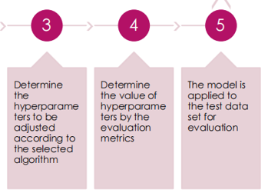
Practice 11: Credit Card Fraud Detection using SVM

